Slide 1
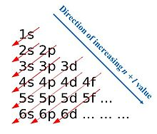
Aufbau Principle
electrons orbiting one or more atoms fill the lowest available energy levels before filling higher levels (e.g., 1s before 2s).

Slide 2
Aufbau Exception 1
Electrons fill the s orbital of a higher energy level before the before filling the d orbital

Slide 3
Aufbau Exception 2
Configurations ending in d⁴ (Group 6)and d⁹ (Group 11)

Slide 4
Pauli Exclusion Principle
states no two electrons can occupy the same orbital with the same spin

Slide 5
Hund’s Rule
Electrons remain unpaired as long as possible

